Slide 1

BLOOD BANK MANAGEMENT SYSTEM
2019505005 - Ahmed Atheeq M A
2019505019 - Karmukilan K T
2019505023 - Kishore Kumar S
2019505028 - Plaban Datta
2019505032 - Pushparaman V
2019505039 – Saaipriya A S
2019505051 - Vasunthradevi V

Slide 2
Blood bank management system :
The main purpose of the MySQL-based blood bank management web application system is to provide the general public with an easier way to store and retrieve data and keep a record of availability of particular blood group and platelets in the database.
After inserting the data into the database, we need not register the same person again.
They can simply search for recorded data and retrieve them for future blood donation or receiving purposes.
This project aims at maintaining all the information pertaining to blood donors, different blood, platelets available in each area and help them manage in a better way for a seamless communication between donors and receivers.

Slide 3
Need for Blood Bank Management System : Blood Bank donation system can collect blood from many donators in short from various sources and distribute that blood to needy people who require blood. This application will try to provide each entity the facility to approach nearby blood donors so that it will become much easier to search rare blood groups in the hour of need. Problems : The major problem in old Blood banking systems was that they don’t follow the actual needs of users. Tracking the database was complicated when the details are maintained manually or as a file . There is a shortage and sometimes unavailability of rare blood groups due to fewer modules and information of patient and donors.
Also due to government and private brokers and blood banks serving as intermediate organizations in between donors and receivers, it leads to significant delay between generating and fulfilling requests.

Slide 4
Aims & Objectives : 1. To bridge the gap between hospitals, volunteer donors and needy people, through this system. 2. To facilitate the search process for needy people and make it easier than before. 3. To reduce the data entry process. 4. To use donor information for locating the hospitals, blood banks and volunteer donors to know if the seeker is near or far. 5. Some blood types are rare so the system can find the required donors with the required blood type easily from the huge database by using the search feature in the app. 6. To provide a dynamic database that is storing donors Information and can communicate with them easily.
Side Note: e-Raktkosh is a pan India government website used to fulfill blood requests however there too blood banks are intermediate between donors and receivers as mentioned earlier thereby our app wishes to overcome these shortcomings.

Slide 5
SCHEMA DESIGN

Slide 6
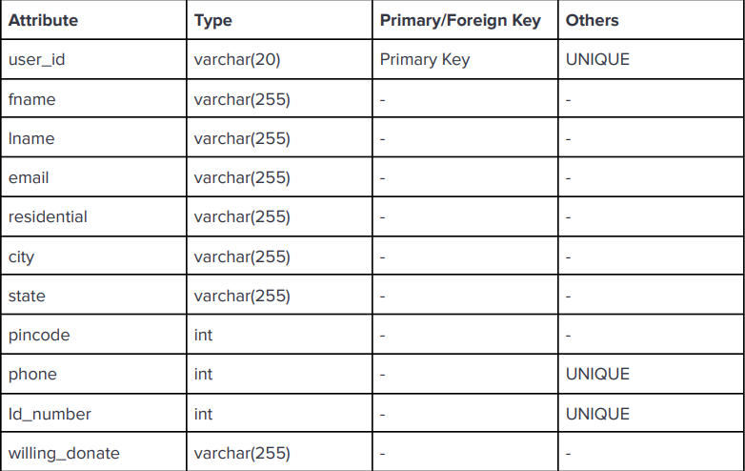
Registered_user :

Slide 7
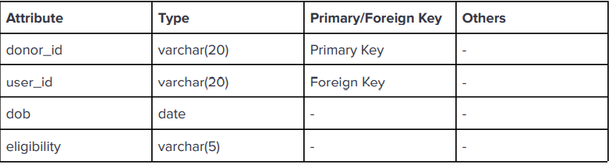
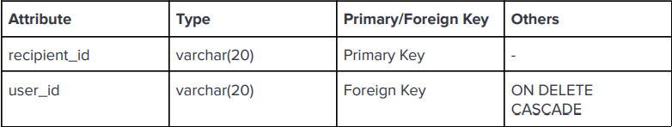
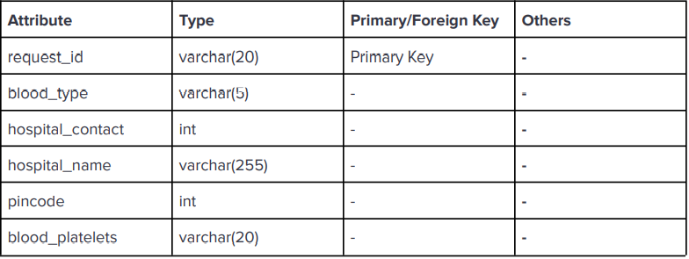
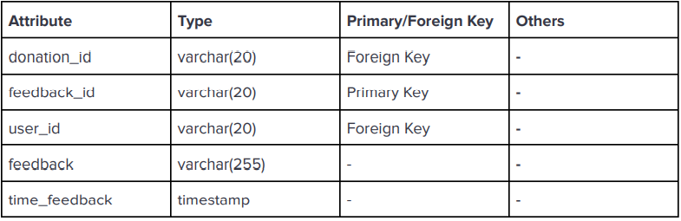
Donor : Recipient :
Blood_info: Feedback:

Slide 8
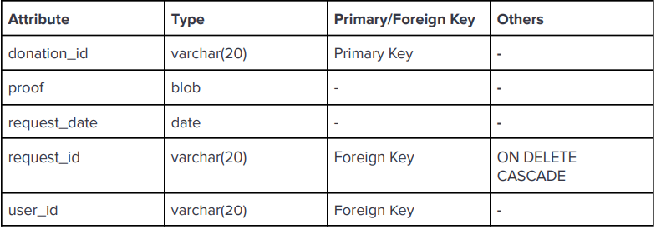
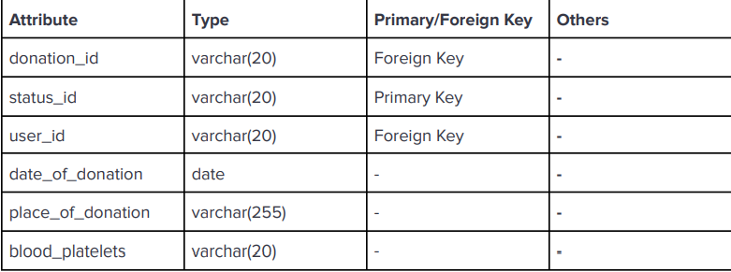
Request_form :
Donation_status:

Slide 9
REFERENTIAL KEY CONSTRAINTS

Slide 10
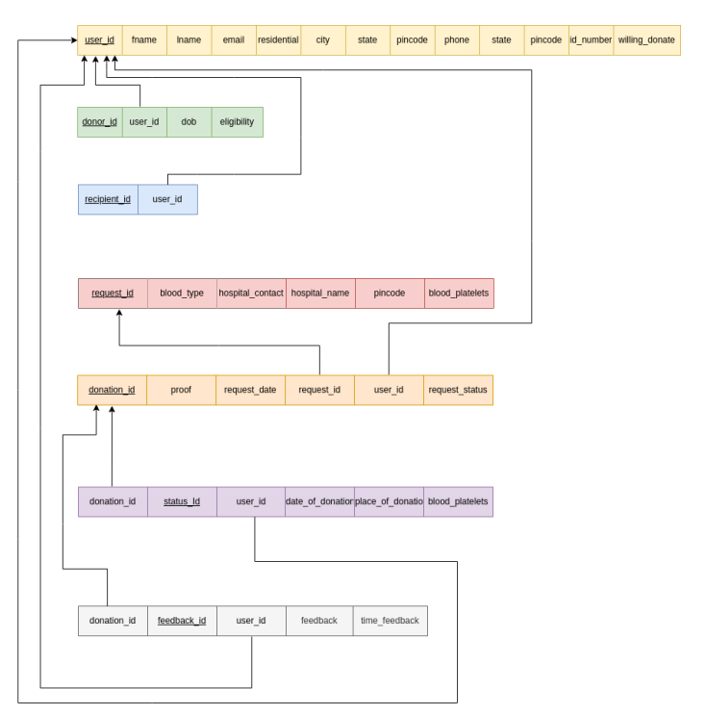

Slide 11
WORKFLOW: As we open the link for our website , we can enter blood group and pin code to get information about the donors and their availability near the pin code. This also contains Steps overview which includes : > Users register / Login to website > To get personal information from donor > Contact and address of Donor > Provide Donor id and user id to uniquely identify the information of donor when entered > Blood information and eligibility of donor , hospital information and availability > Request form for donation to the donor for blood donation with date > Donation status regarding information of donation - date and place of donation > Feedback form to get the feedback from the donor

Slide 12
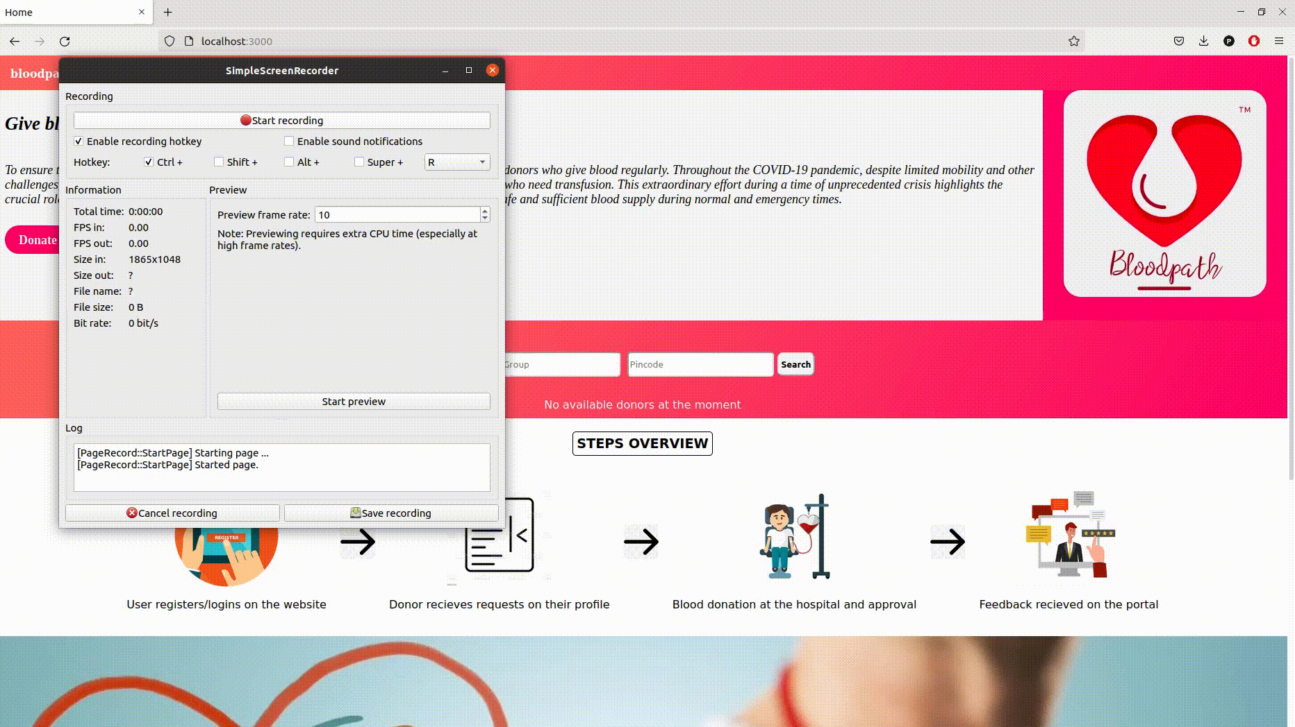
LANDING PAGE

Slide 13
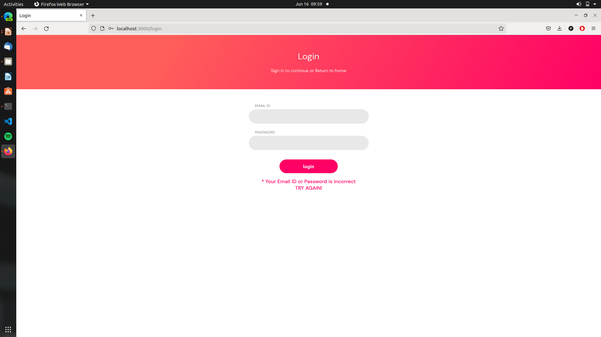
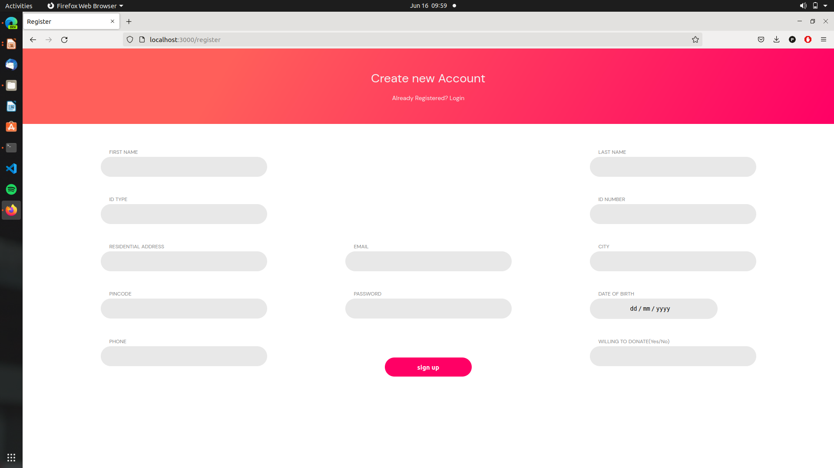
Step 1: User / Donor has to create an account with personal information to get and save information for relation registered _user . Information of donor will be saved in the database and user has to enter a password for further login . Once registered , user can login using email and password.

Slide 14
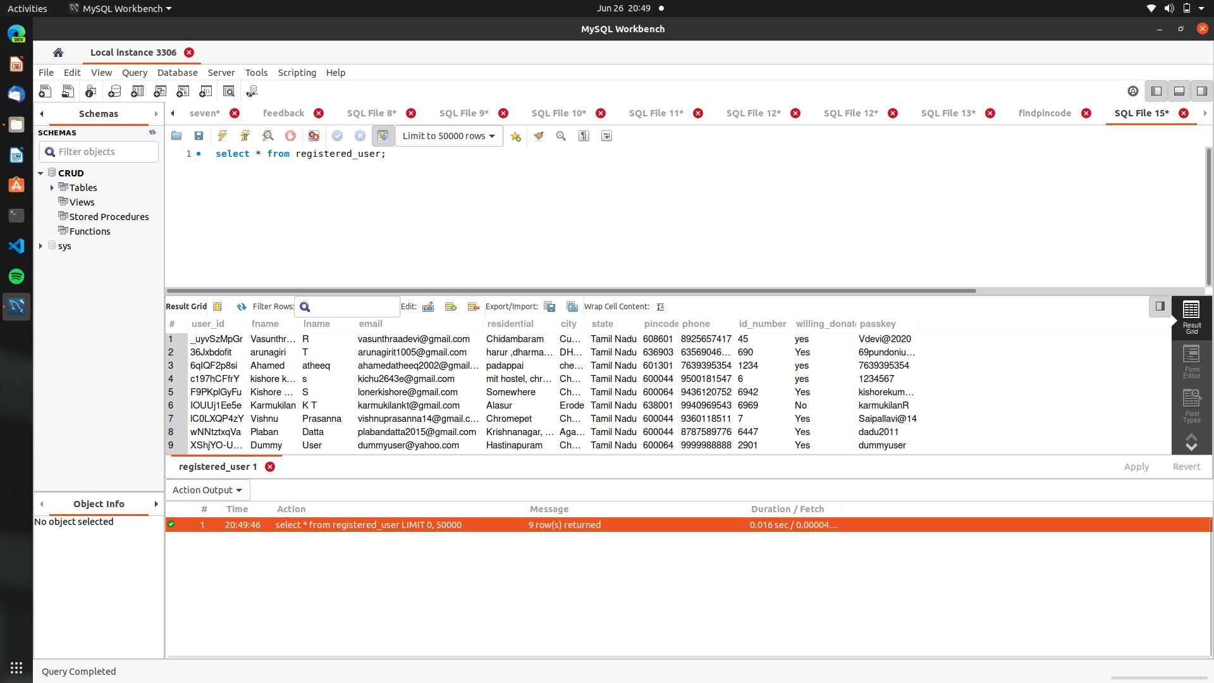
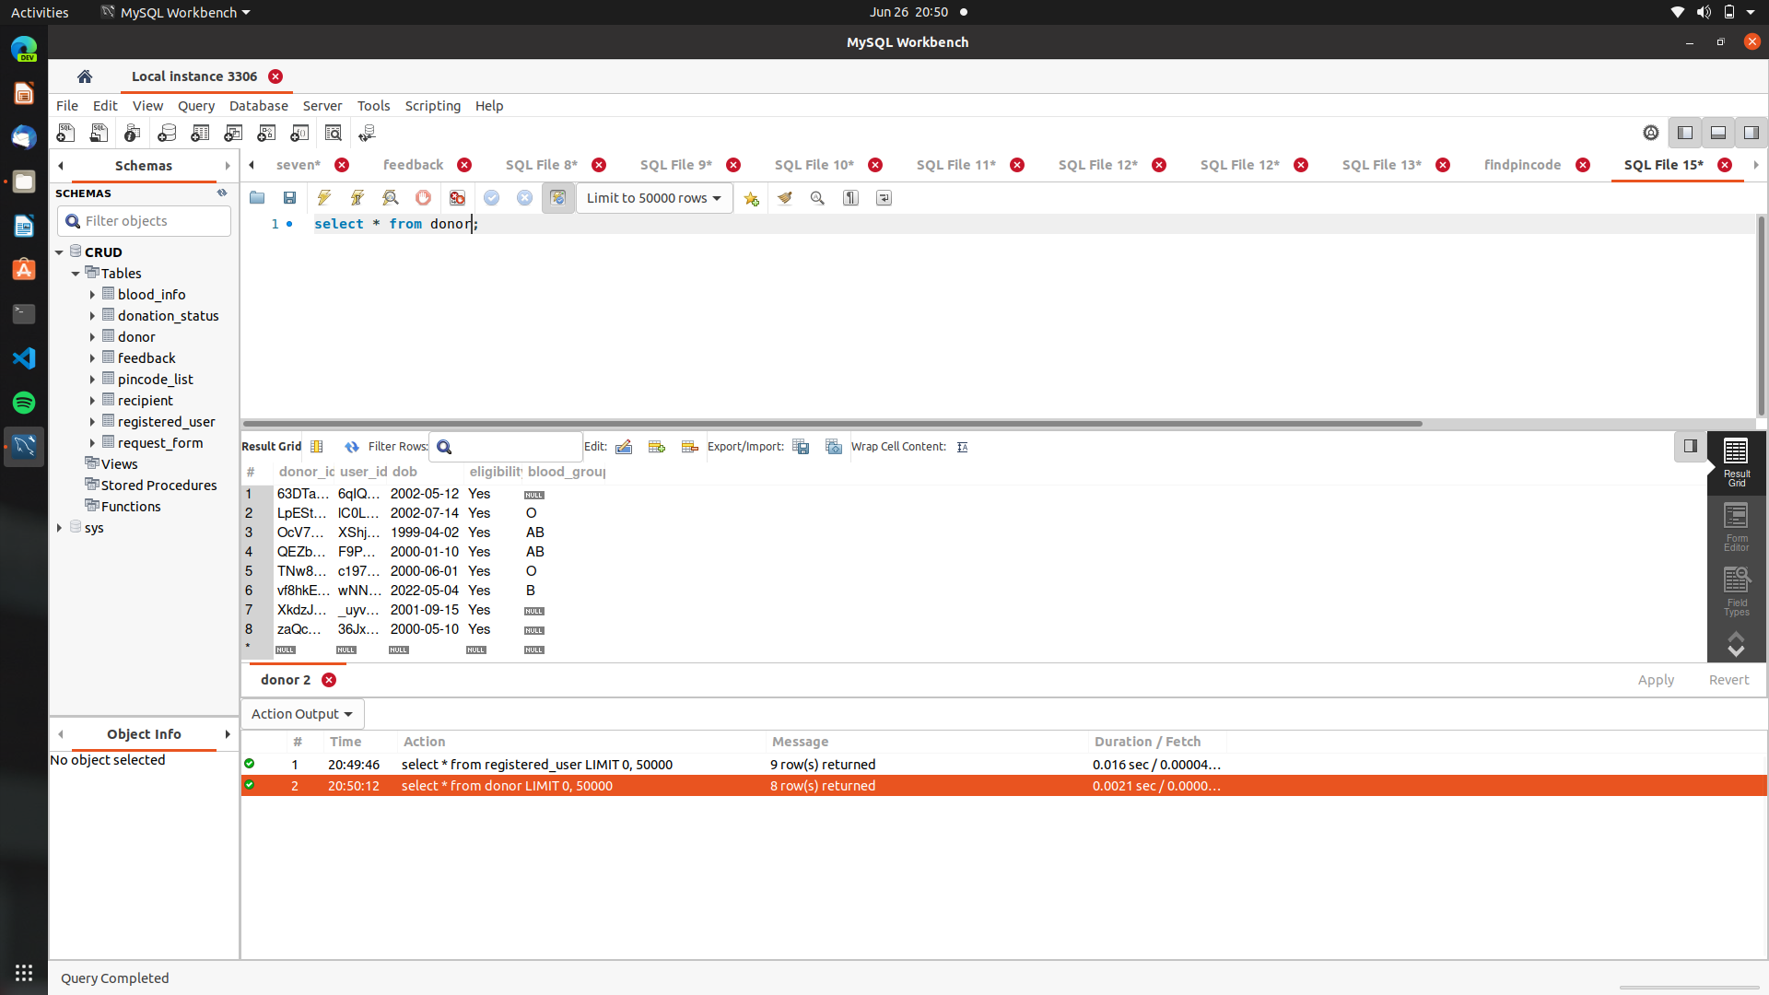
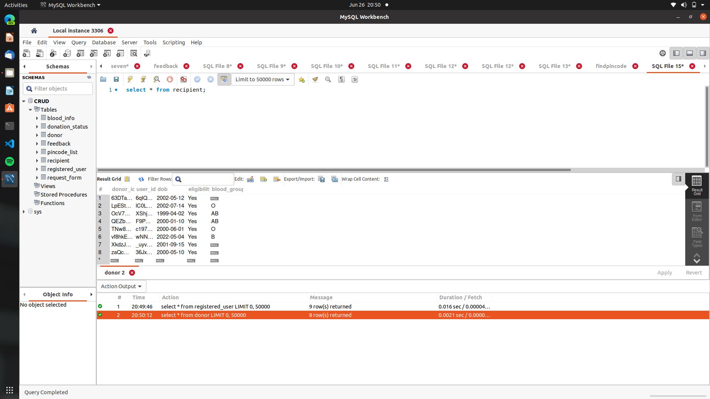
Database Screenshots

Slide 15
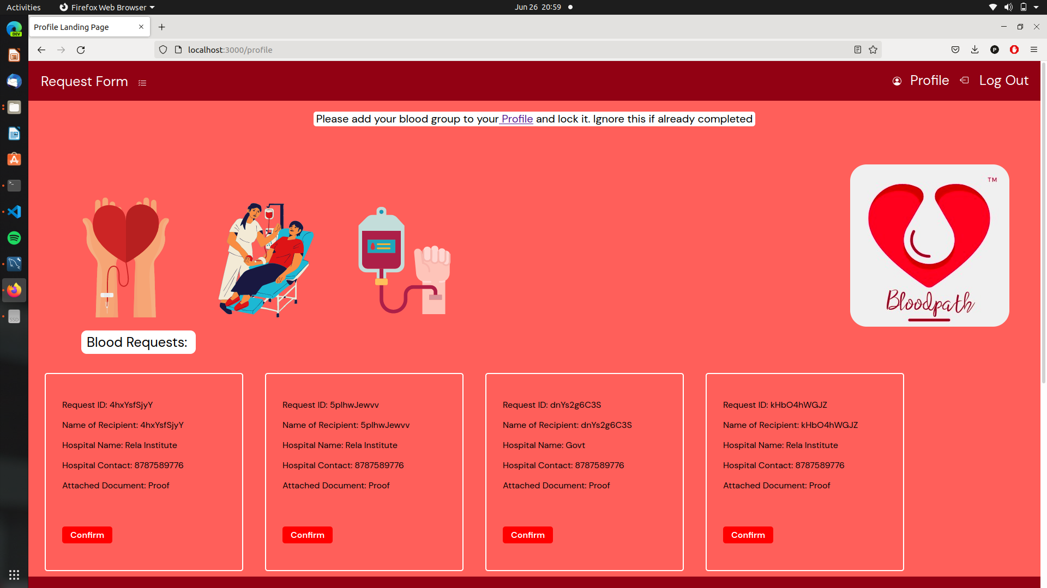
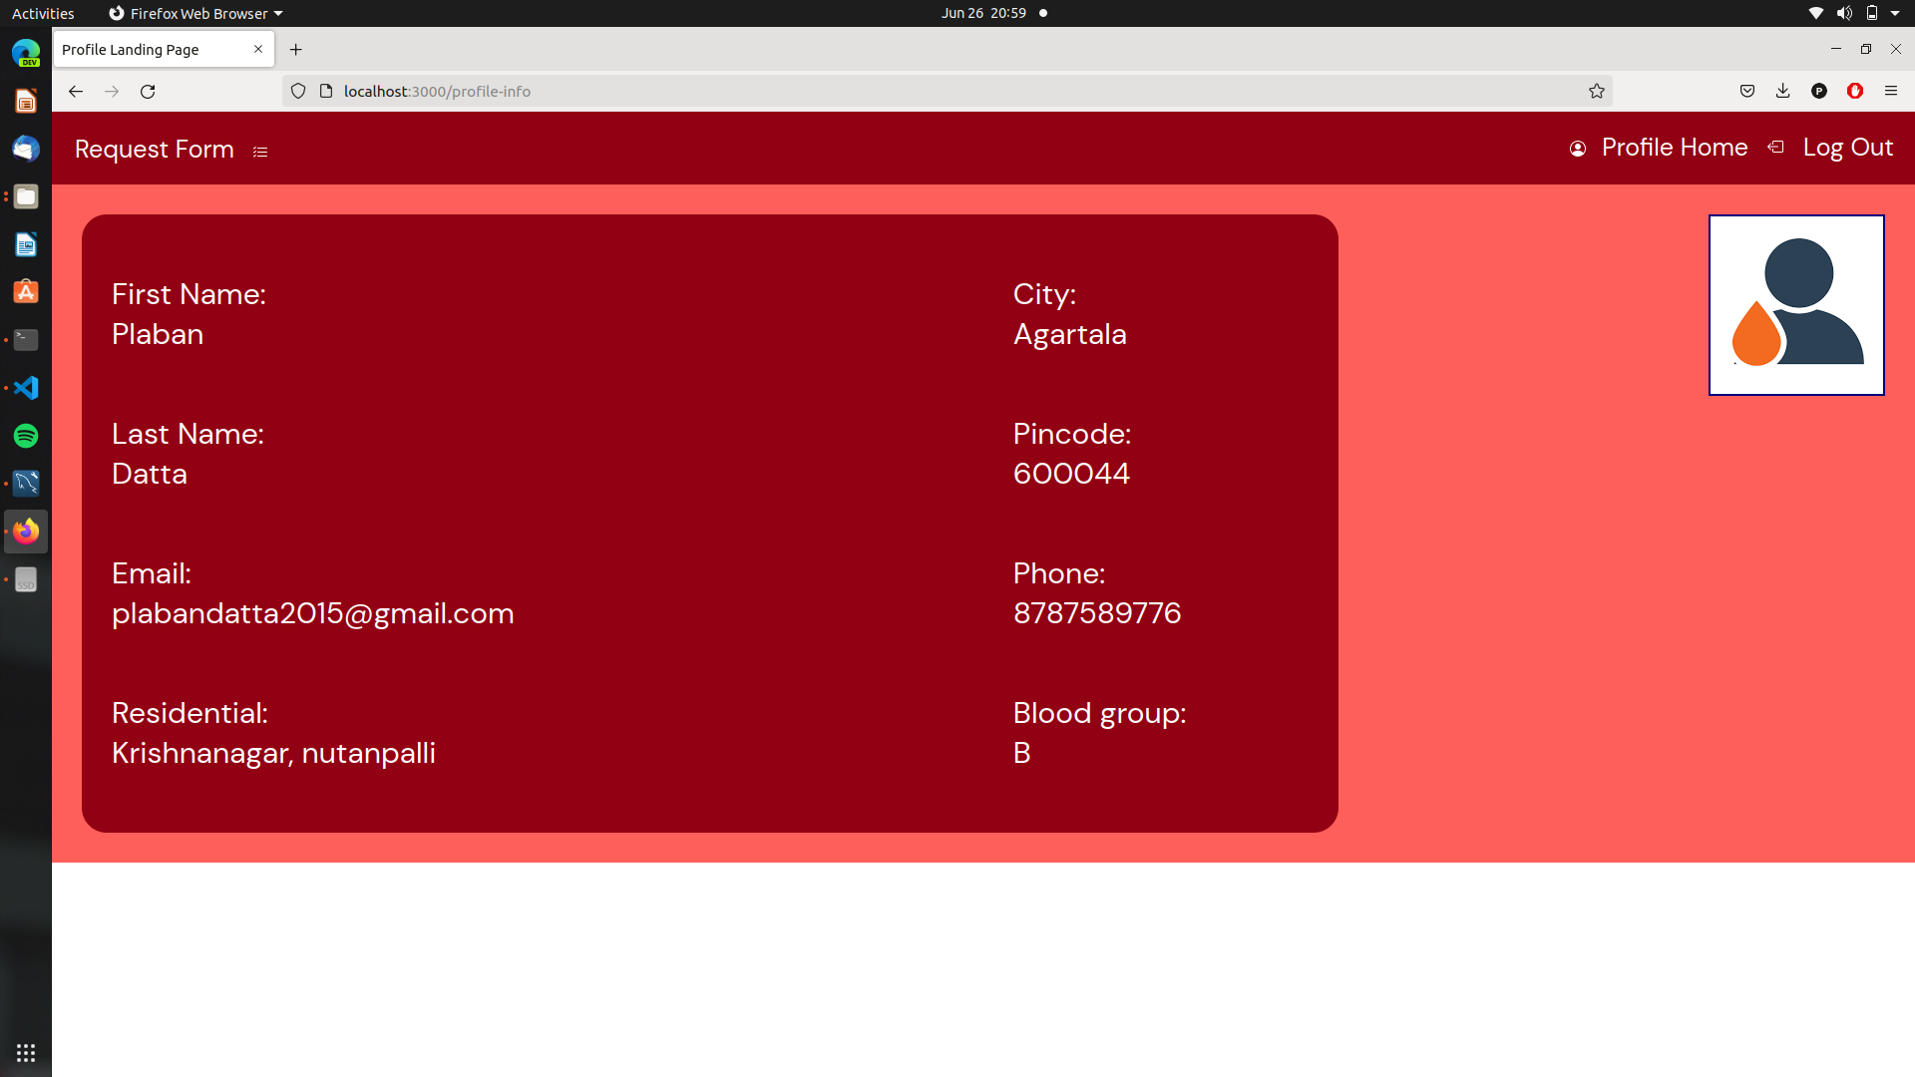
Main Profile Page

Slide 16
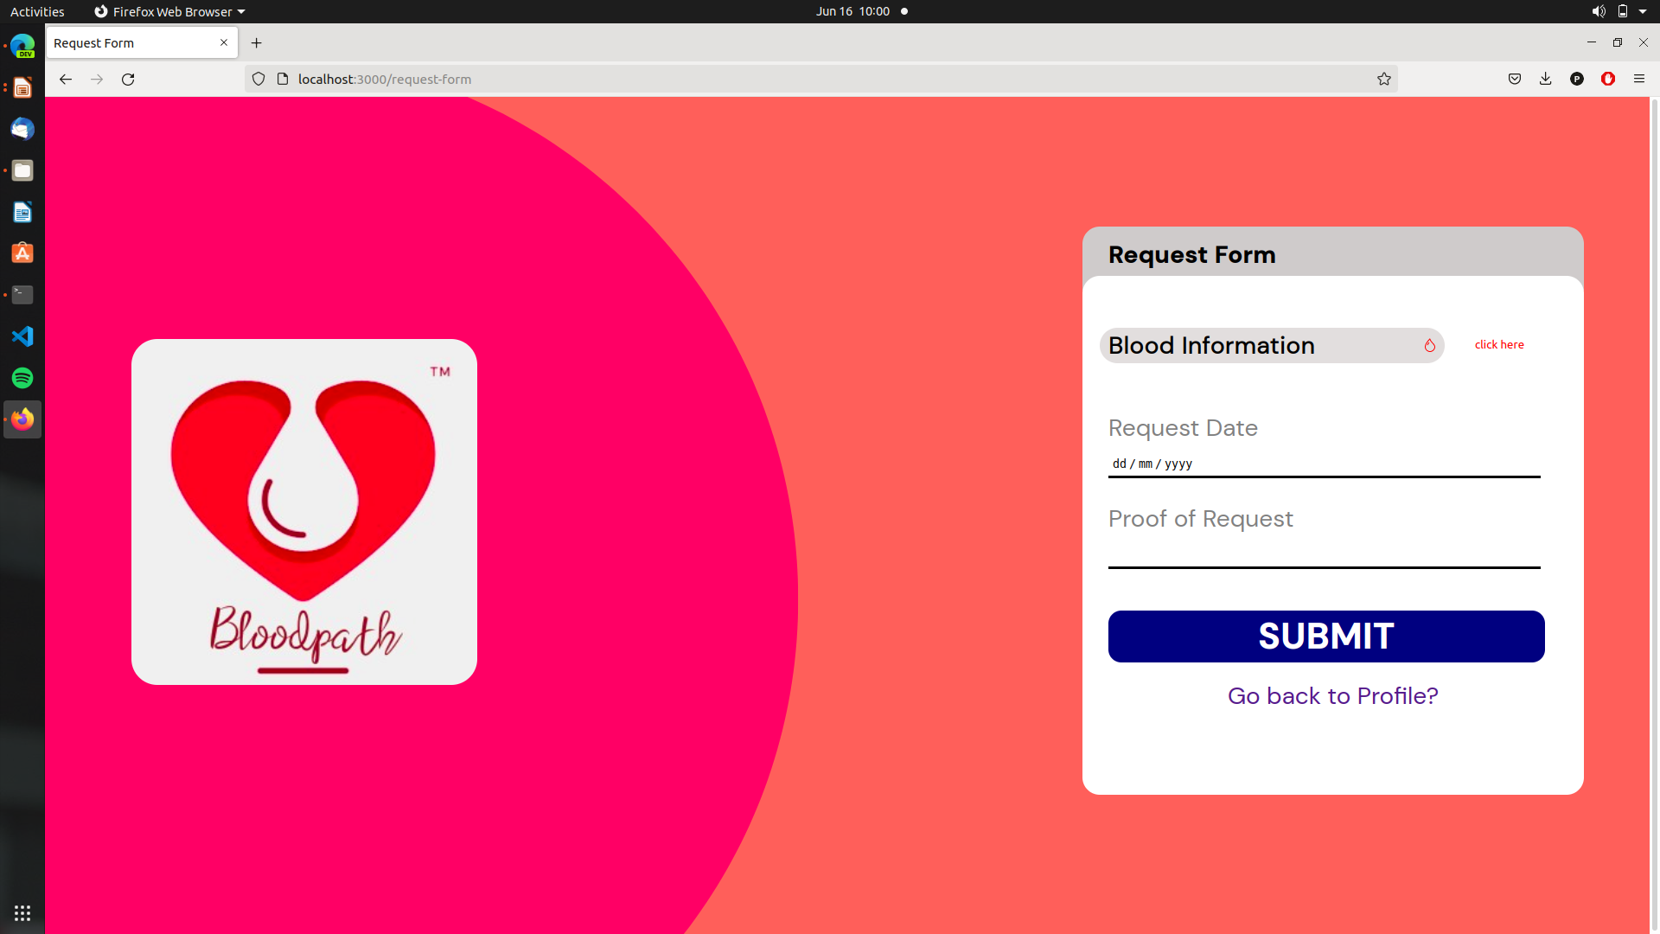

Slide 17
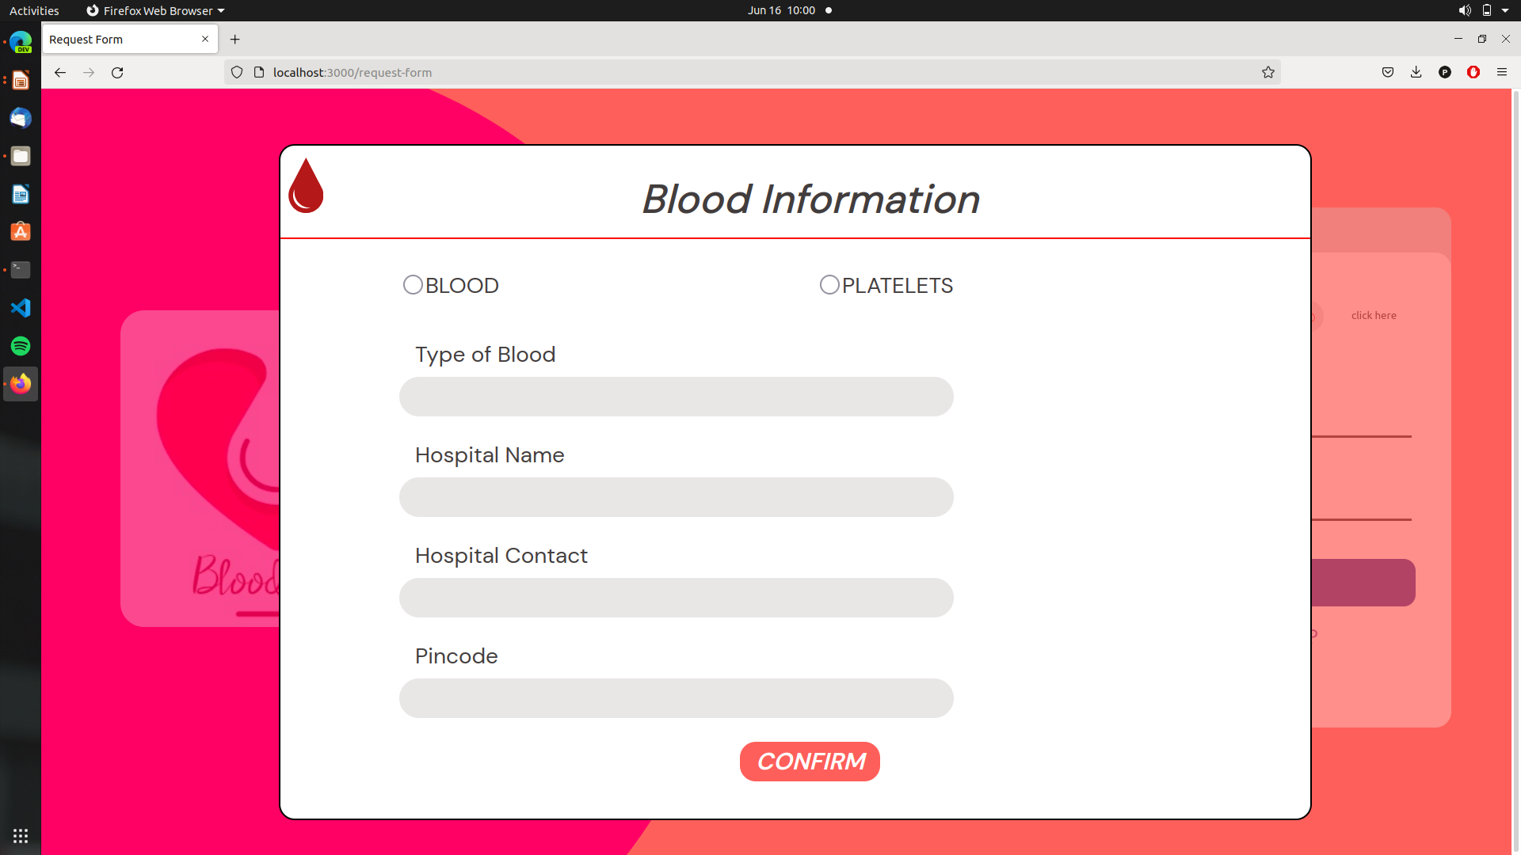
Request form : Donor will get requests from different places for blood donation of particular blood group and platelets . This is requested based on the donor information and address for nearby area from the place of donation to the place of donor
Once the request has been accepted , blood information , request date and proof of request will be asked to the donor for saving information as proof of donation

Slide 18
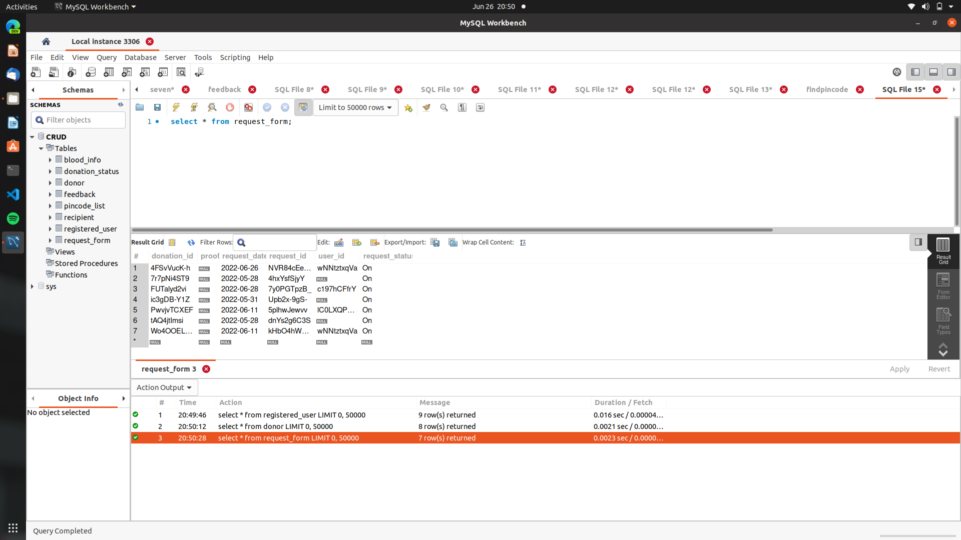
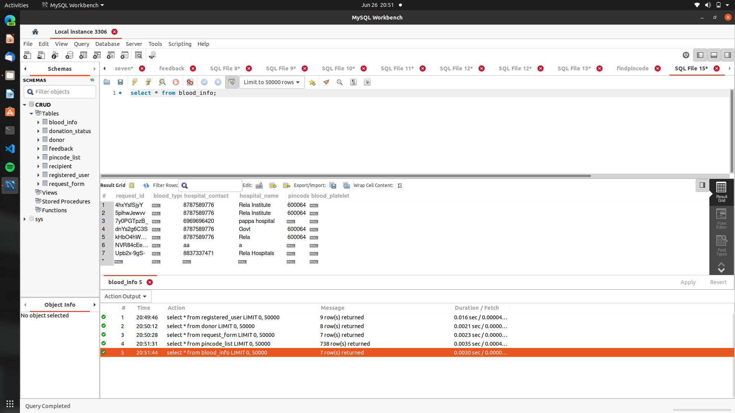
Database Screenshots

Slide 19
Main Profile Page

Slide 20
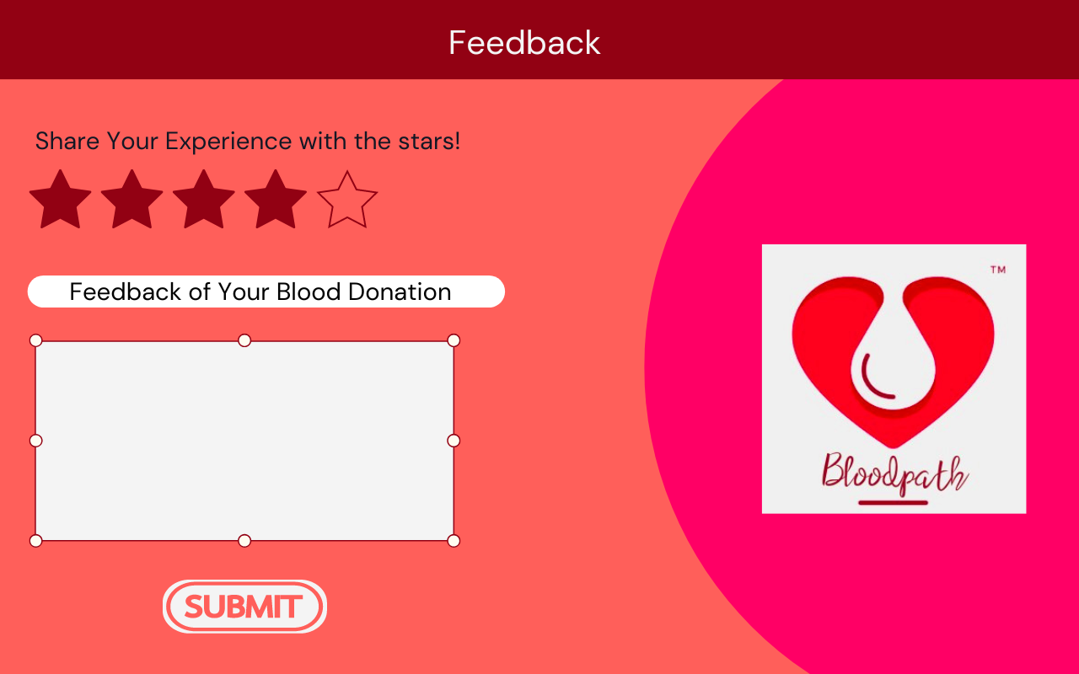
Feedback Page

Slide 21
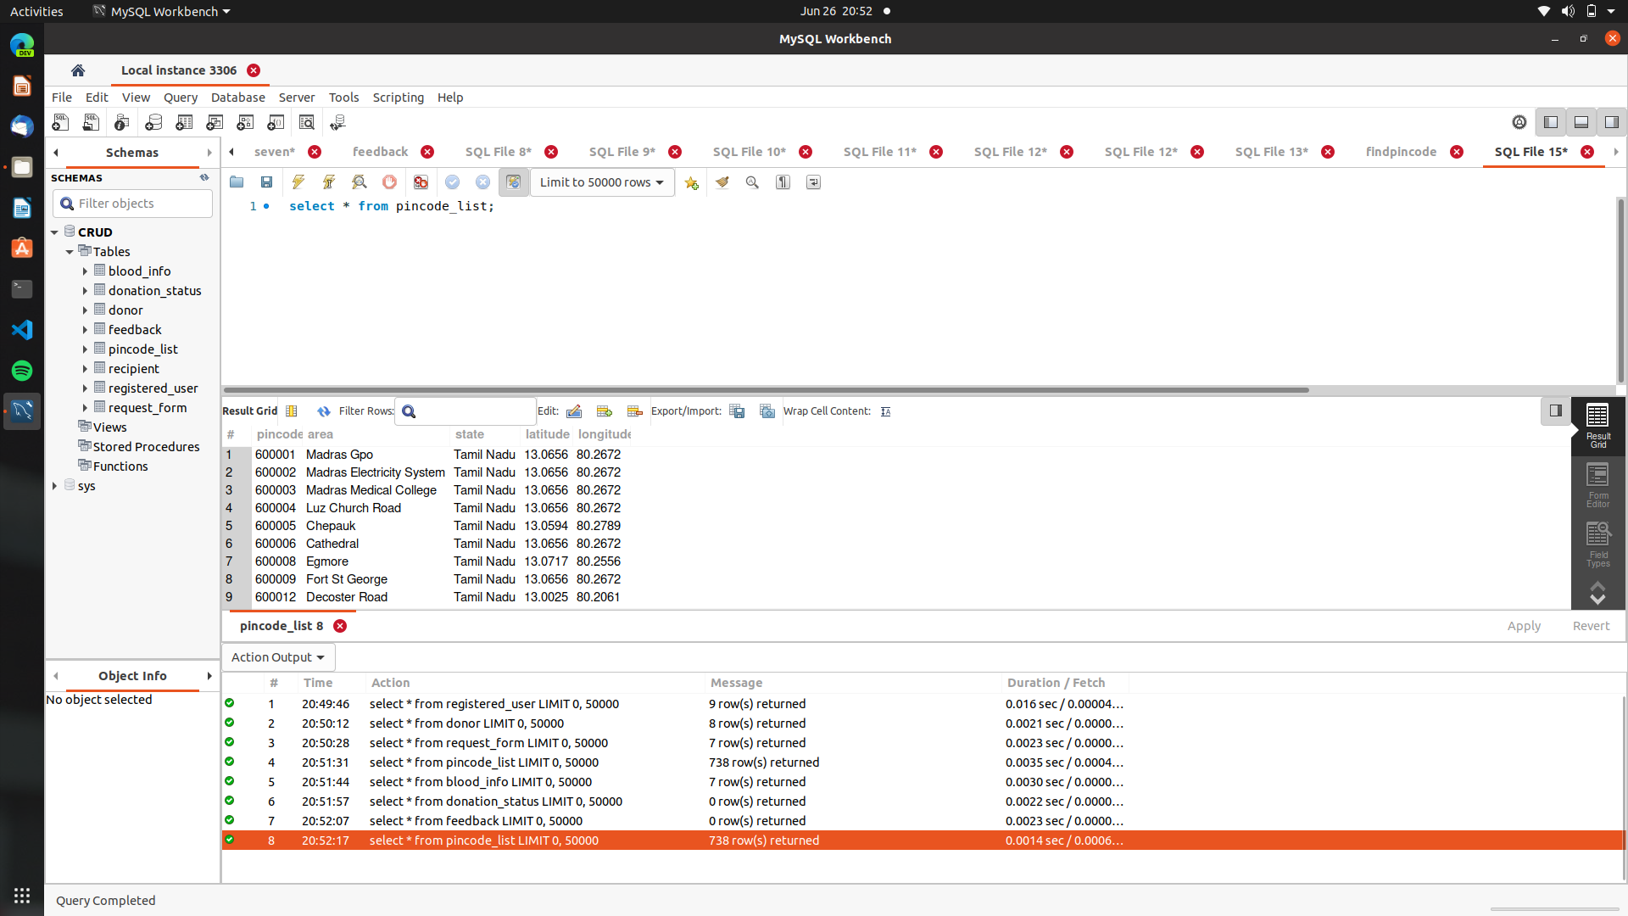
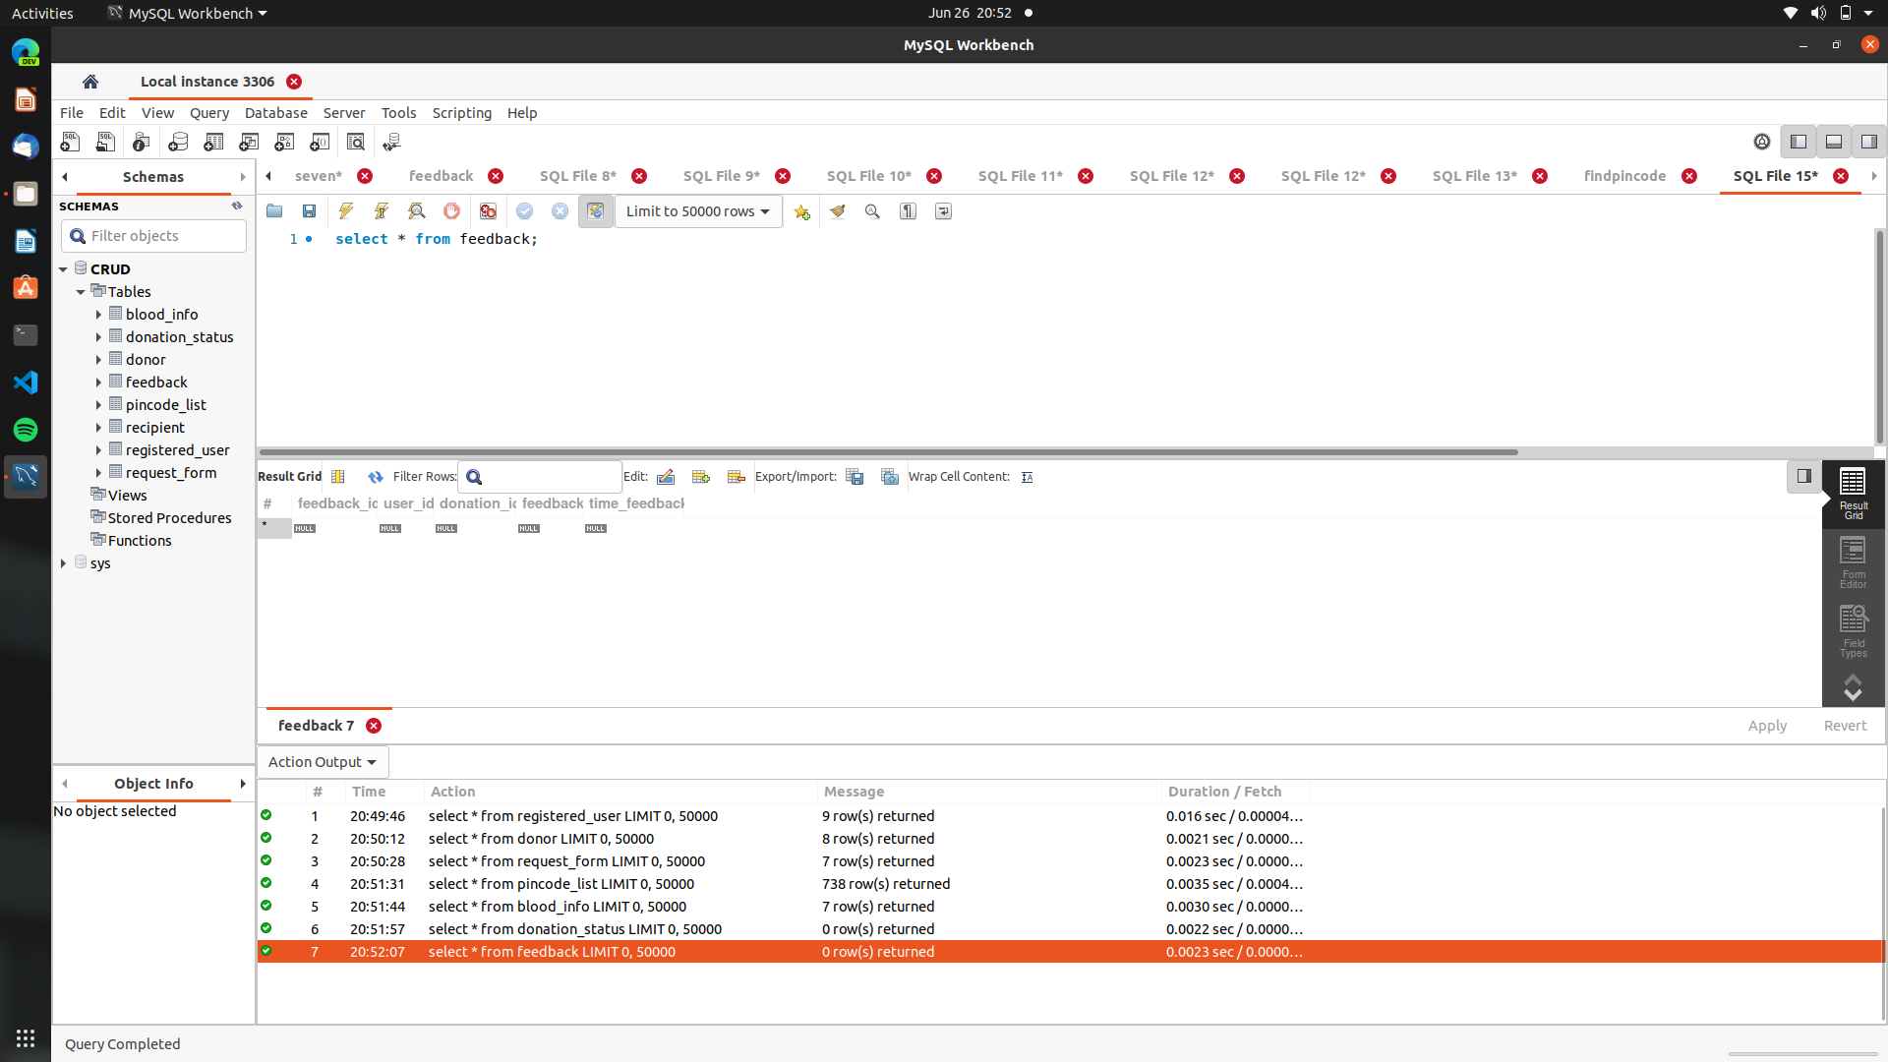
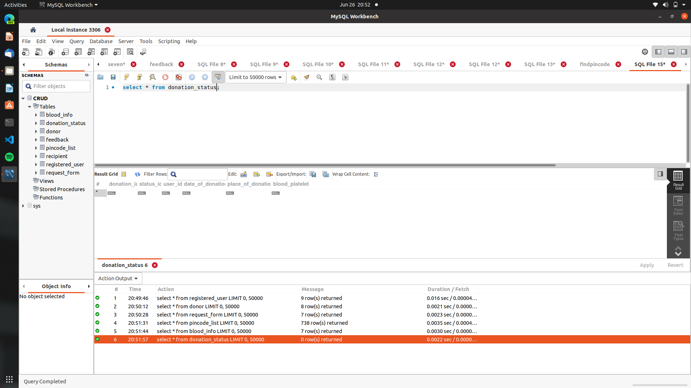
Database Screenshots

Slide 22

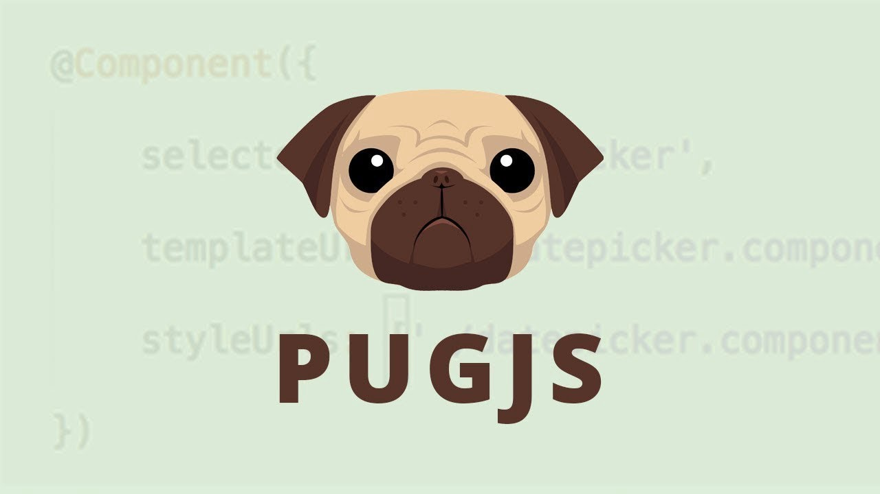
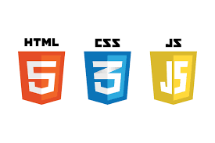
SOFTWARES USED
Frontend Design

Slide 23

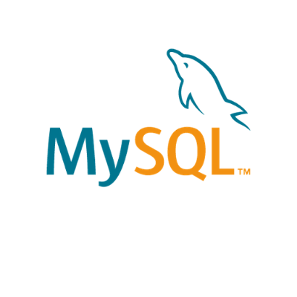

Backend/Database Design

Slide 24
Conclusion
Thereby our app aims at connecting the donors and recipients in the shortest time possible so as to reduce the time and workload required to satisfy urgent requests.
In the future this can be implemented in both small and large scale applications by doing the required improvements and extending security features.

Slide 25
THANK YOU

